Slide 1
Mechanical Ventilation Preceptorial
NOTE: This is the template deck - please download a copy or save a copy to your personal Google Drive. Do NOT directly edit/save on this version.
Learner:
Preceptor:

Slide 2
Welcome and Instructions
Welcome to the Ventilator Preceptorial 2025-2026! This is a template deck for your waveform submissions. Please create a Google Slides copy or download a copy for yourself to edit and then share as indicated.
While this deck will take time and effort to complete, it will serve as your teaching deck moving forward in your career.
Please review the list of required waveform submissions and note the due dates. We recommend completing waveforms ahead of time as you will likely see asynchronies before you are formally tested on them - feel free to discuss with your preceptor/attending if having difficulty categorizing.
If waveforms are not submitted by the due date, you will be unable to complete the preceptorial program.

Slide 3
Portfolio Fall Summary Requirements
Due Date | Requirement
Due November 15, 2025 (Or at least 1 week before Chapter D meeting) Please Note: All above waveforms (if any missed) are also due at this time | Normal Waveforms (Please submit all): Normal Pressure Control Breath Normal Volume Control Square Waveform Breath Normal Volume Control Decelerating Waveform Breath Normal Volume Targeted Breath Normal Passive Expiration Normal Pressure Support Breath Maneuvers (Please submit all): Plateau pressure (Pplat) measurement Serial Measurement of Pplat at different PEEP levels Measurement of Static Compliance Measurement of Inspiratory Resistance Calculating Tau Measurement of zero autoPEEP Measurement of AutoPEEP >2 cmH2O Features Concerning for the Presence of autoPEEP (Please submit at least 1 of any of the following): Unequal Areas of Flow-Time Curve Persistent End Expiratory Flow Ineffective Triggering - if submitting as feature of autoPEEP, please also submit screen showing measured autoPEEP Expiratory Asynchronies (Please submit all): Active expiration AutoPEEP (as noted above) and Management Trigger Asynchronies (Please submit all): Autotrigger and Management Ineffective Trigger and Management Reverse Trigger and Management Double Trigger and Management

Slide 4
Portfolio Spring Summary Requirements
Due Date | Requirement
Due April 17, 2026 (Or at least 1 week before Chapter H meeting) | Flow Asynchronies (Please submit all): Flow Starvation on Pressure Control and Management Flow Starvation on Volume Control Decelerating Waveform and Management Flow Starvation on Volume Targeted and Management Cycle Asynchronies (Please submit all): Premature Cycling on Pressure Control and Management Premature Cycling on Volume Control and Management Delayed Cycling on Pressure Control and Management Delayed Cycling on Volume Control and Management Other Cases and Maneuvers (Please submit at least 2 of the following): Breath Termination on Pressure Support Ventilation (PSV) - Expiratory Sensitivity (ESENS) adjustment for patient on PSV Recruitment-Inflation Ratio Measurement Increased Pressure-Time Product Dynamic Airway Collapse During Exhalation APRV Esophageal Manometry Guiding PEEP Titration Low-Flow Pressure Volume Loop Mechanical Ventilation on VV ECMO
Due May 15, 2026 | You may be asked to edit / correct your submitted images. If so, they must be turned in prior to scheduling the June Final Assessment

Slide 5
Sample Submissions
Slide Title = name of requirement
Each requirement will take 1-3 slides to complete:
  Slide A will have your picture of the waveform submission (including Pressure-Time, Flow-Time, and Volume-Time curves) and a brief description of patient case or the maneuver you are completing
  Slide B should include your annotations (you can use a stylus to draw normal expected waveforms; otherwise, use colored arrows or shapes in powerpoint to identify key findings) and include a brief description of your management
  Slide C (if applicable) - waveforms after maneuver/adjustment
Please note: It is okay to submit the same image for multiple requirements, but it must be annotated appropriately. (For example, can submit same image for Normal Pressure Control and Normal Passive Expiration if annotated appropriately, or if you see multiple asynchronies on the same view.)

Slide 6
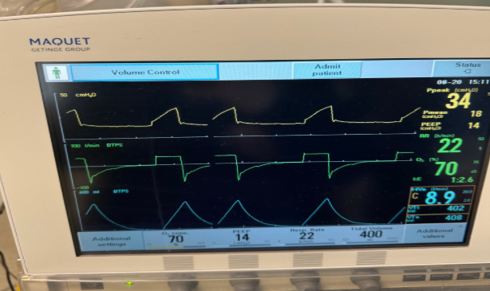
Normal Volume Control - Square Wave
SAMPLE 1 - Normal Waveform
45 yo F, intubated on volume control ventilation after found down and unable to protect airway and reported concern for aspiration. Settings from ED on transfer to MICU.
-On propofol + fent gtt
Main Menu

Slide 7
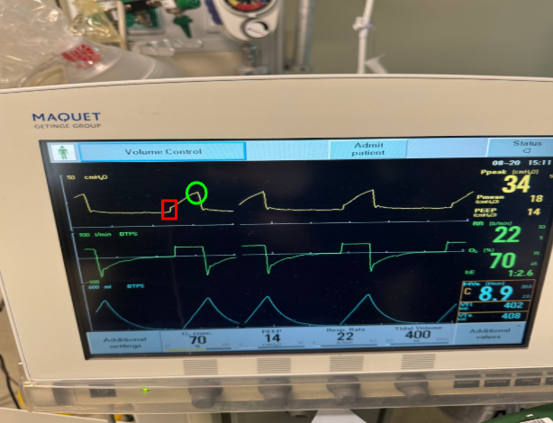
Normal Volume Control - Square Wave
SAMPLE 1 - Normal Waveform
Green - Peak inspiratory pressure (PIP)
Red - FxR (resistive) component of the pressure-time curve
Initial Management:
1) Obtain ABG if has not yet been completed. Measure height to ensure TV is appropriate.
2) Check Pplat with set PEEP 14. Consider driving pressure trial. If oxygenating fine, consider FiO2 reduction.
Main Menu

Slide 8
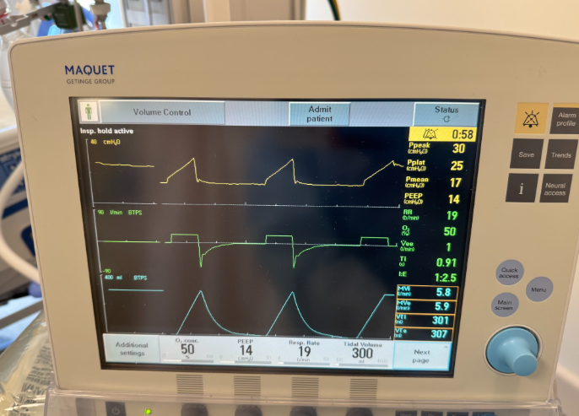
Calculating Resistance and Compliance
SAMPLE 2 - Maneuvers
R=(PIP-Pplat)/F
R=(30cmH2O-25cmH2O)/0.333L/s
R=15cmH2O/L/s
C= ΔV/ΔP
C=Vt/(Pplat-PEEP)
C=0.3L/(25cmH2O-14cmH2O)
C=0.0273L/cmH2O
Main Menu

Slide 9
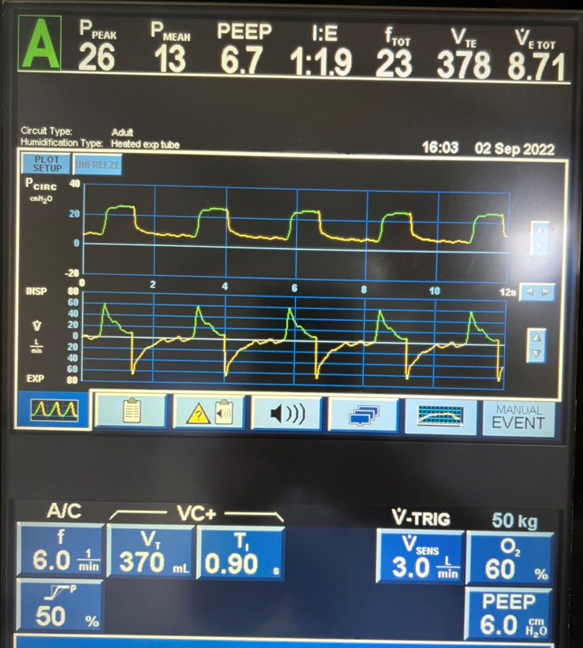
Auto-Trigger A
SAMPLE 3 - Asynchronies
65 yo M, intubated on volume target, now with increased RR
-On propofol + fent gtt
Main Menu

Slide 10
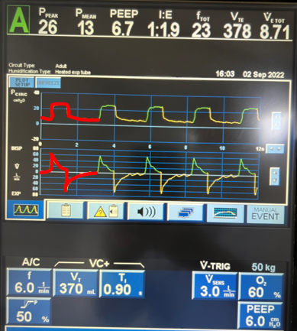

Auto-Trigger B
SAMPLE 3 - Asynchronies
Normal VT breath outlined over the waveform in red
Note: variable deflections in expiratory limb of pressure-time and flow-time curve
Suspect auto-trigger given the regular rate of oscillations; can adjust trigger sensitivity, evaluate for any sources of leak.
Main Menu

Slide 11
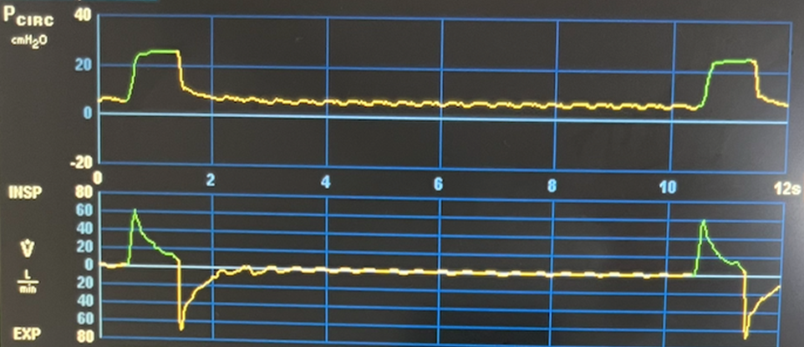
Auto-Trigger C
SAMPLE 3 - Asynchronies
When trigger sensitivity was adjusted, oscillations were revealed which greatly exceed a plausible respiratory rate.
Main Menu

Slide 12
Normal Ventilator Waveforms
Main Menu

Slide 13
Normal PC Breath
Brief Case Description:
Main Menu

Slide 14
Normal VC - Square Breath
Brief Case Description:
Main Menu

Slide 15
Normal VC - Decel Breath
Brief Case Description:
Main Menu

Slide 16
Normal Passive Expiration
Brief Case Description:
Main Menu

Slide 17
Normal Volume Target Breath
Brief Case Description:
Main Menu

Slide 18
Patient on Pressure Support Ventilation (Normal PS Breath)
Brief Case Description:
Main Menu

Slide 19
Maneuvers
Main Menu

Slide 20
Plateau Pressure Measurement
Brief Description of Maneuver:
Main Menu

Slide 21
Serial Measurement of Pplat at Different PEEP Levels
Pplt for PEEP 1
Pplt for PEEP 2
Pplt for PEEP 3
Question to Answer/Discuss: What have you completed by doing these serial measurements? How will this aid your management?
Main Menu

Slide 22
Measurement of Static Compliance
Brief Description of Maneuver:
Main Menu

Slide 23
Measurement of Inspiratory Resistance
Brief Description of Maneuver:
Main Menu

Slide 24
Calculating tau
Brief Description of Maneuver:
Question to Answer/Discuss: You may use any method, please show your work and describe how it impacted your settings.
Main Menu

Slide 25
Measured AutoPEEP of 0 cmH2O
Brief Description of Maneuver:
Main Menu

Slide 26
Expiratory Asynchronies
Main Menu

Slide 27
Active Expiration
Brief Description of Maneuver:
Main Menu

Slide 28
Measured AutoPEEP >2 cmH2O
Brief Description of Maneuver:
Main Menu

Slide 29
Management of autoPEEP
Brief Description of Maneuver:
Main Menu

Slide 30
Unequal Areas of Flow-Time Curve
Brief Description of Case:
Main Menu

Slide 31
Persistent End Expiratory Flow
Brief Description of Case:
Main Menu

Slide 32
Flow Asynchronies
Main Menu

Slide 33
Flow Starvation on Pressure Control
Image
Brief Case Description
Main Menu

Slide 34
Management of Flow Starvation on PC
Flow Starvation Management
Case Description
Main Menu

Slide 35
Flow Starvation on Volume Control Decel
Image
Brief Case Description:
Main Menu

Slide 36
Management of Flow Starvation on VC
Flow Starvation Management
Case Description
Main Menu

Slide 37
Flow Starvation on Volume Target
Image
Brief Case Description:
Main Menu

Slide 38
Management of Flow Starvation on VT
Flow Starvation Management
Brief Description of Case
Main Menu

Slide 39
Trigger Asynchronies
Main Menu

Slide 40
Ineffective Triggering
Brief Description of Case:
Main Menu

Slide 41
Management of Ineffective Triggering
Brief Description of Case and Management:
Main Menu

Slide 42
Auto-Trigger
Brief Description of Case:
Main Menu

Slide 43
Management of Auto Trigger
Brief Description of Case:
Main Menu

Slide 44
Double Trigger
Brief Description of Case:
Main Menu

Slide 45
Management of Double Trigger
Brief Description of Case:
Main Menu

Slide 46
Reverse Trigger
Brief Description of Case:
Main Menu

Slide 47
Management of Reverse Trigger
Brief Description of Case:
Main Menu

Slide 48
Cycle Asynchronies
Main Menu

Slide 49
Premature Cycling on Pressure Control
Brief Description of Case and Management:
Main Menu

Slide 50
Premature Cycling on Volume Control
Brief Description of Case and Management:
Main Menu

Slide 51
Management of Premature Cycling
Brief Description of Case and Management:
Main Menu

Slide 52
Delayed Cycling on Pressure Control
Brief Description of Case and Management:
Main Menu

Slide 53
Delayed Cycling on Volume Control
Brief Description of Case and Management:
Main Menu

Slide 54
Management of Delayed Cycling
Brief Description of Case and Management:
Main Menu

Slide 55
Breath Termination Criteria on PSV - ESENS Adjustment
Brief Description of Case:
Main Menu

Slide 56
Other Cases
Please submit at least 2 of the listed cases here.
You may add additional interesting cases you see to this section.
Main Menu

Slide 57
Expiratory Sensitivity (ESENS) Adjustment; Patient on PSV
Brief Description of Case and Management:
Question to Answer/Discuss: Please discuss the initial ESENS settings and how/why you adjusted it, please enclose a picture of the patient on your new settings.
Main Menu

Slide 58
Recruitment-Inflation Ratio Measurement
Brief Description of Case and Management:
Question to Answer/Discuss: Please be ready to demonstrate your calculations.
Main Menu

Slide 59
Increased Pressure-Time Product
Brief Description of Case and Management:
Main Menu

Slide 60
Dynamic Airway Collapse
Brief Description of Case and Management:
Question to Answer/Discuss: Discuss ventilatory challenges and strategies to mitigate the effects.
Main Menu

Slide 61
APRV
Brief Description of Case and Management:
Question to Answer/Discuss: Please describe how you obtained your initial settings (for example: can discuss setting Tlow based on
calculation of tau, how to ensure tidal volume remains in lung protective ventilation ranges, etc.)
Main Menu

Slide 62
Esophageal Manometry to Guide PEEP Titration
Brief Description of Case and Management:
Question to Answer/Discuss: Please describe how this impacts your baseline ventilator settings (i.e. set PEEP).
Main Menu

Slide 63
Low-Flow Pressure Volume Loop
Brief Description of Case and Management:
Question to Answer/Discuss: Please describe how this impacts your baseline ventilator settings (i.e. set PEEP).
Main Menu

Slide 64
Mechanical Ventilation of Patient on V-V ECMO
Brief Description of Case and Management:
Main Menu

